Slide 1
DYNAMIC ANALYSIS
Interaction-entity graph
I-E graph clusters
Running system
Usages
Optimization
Weighted information graph
Decomposition
SCA-BASED
Entities subgraph
Entity clusters
Source code
Information Graph
Optimization
Communities

Slide 2
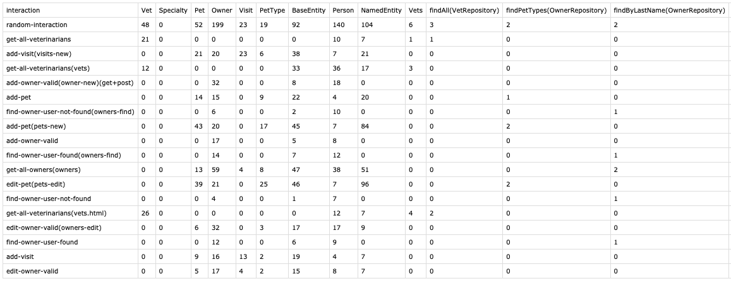
Nodes of the information graph
Methods
Entities
Interactions

Slide 3
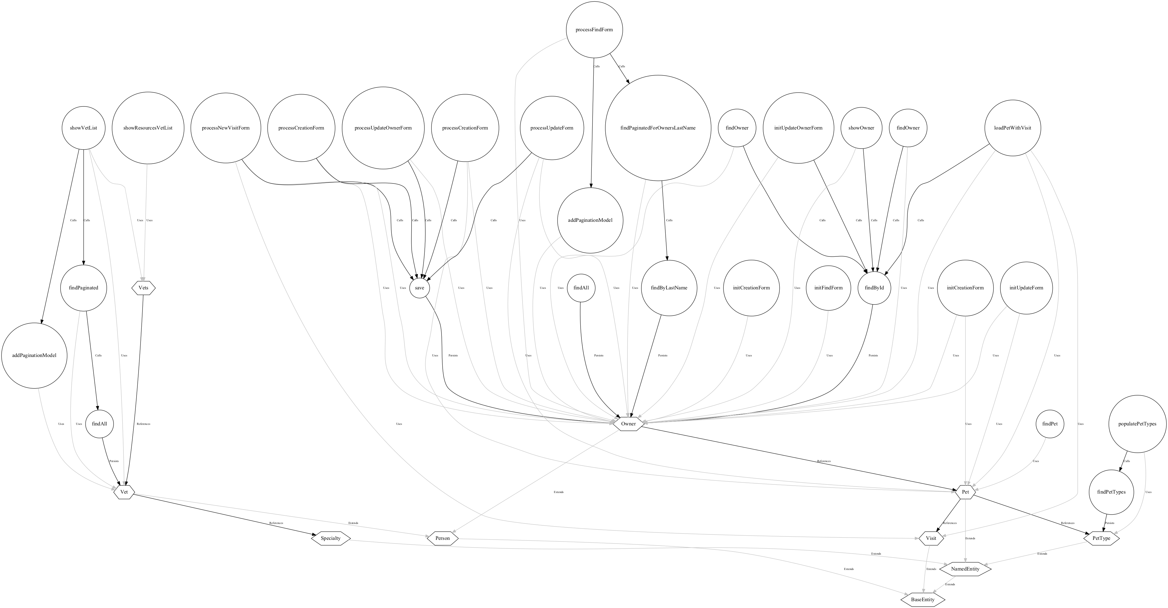

Slide 4
